Slide 1
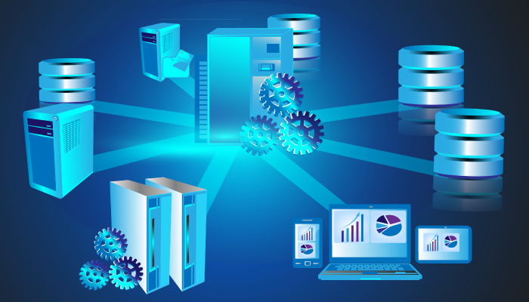
Introduction to Database
Saadani Mohamed Amine

Slide 2
List of contents :
1-What is a database ?
2-Types of databases
3-What is an RDBMS ?
4-Three examples of popular RDBMS
4-a-MySQL : Introduction and functionalities
4-b-PostgreSQL :Introduction and functionalities
4-c-SQL SERVER:Introduction and functionalities
5-Difference between three above

Slide 3

1-What is a database ?
A database is an organized collection of structured information, or data, typically stored electronically in a computer system. A database is usually controlled by a database management system (DBMS). Together, the data and the DBMS, along with the applications that are associated with them, are referred to as a database system, often shortened to just database.

Slide 4
2-Types Of databases :
There are many different types of databases.The best choise for any organisation depends on how the organisation intends to use the data. Here,we will list most used types of dbs :
Relational databases: Relational databases became dominant in the 1980s. Items in a relational database are organized as a set of tables with columns and rows. Relational database technology provides the most efficient and flexible way to access structured information.
Object-oriented databases: Information in an object-oriented database is represented in the form of objects, as in object-oriented programming.
Distributed databases: A distributed database consists of two or more files located in different sites. The database may be stored on multiple computers, located in the same physical location, or scattered over different networks.

Slide 5
Data warehouses : A central repository for data, a data warehouse is a type of database specifically designed for fast query and analysis.
NoSQL databases: A NoSQL, or nonrelational database, allows unstructured and semistructured data to be stored and manipulated (in contrast to a relational database, which defines how all data inserted into the database must be composed). NoSQL databases grew popular as web applications became more common and more complex.
Graph databases: A graph database stores data in terms of entities and the relationships between entities.
OLTP databases: An OLTP database is a speedy, analytic database designed for large numbers of transactions performed by multiple users.
Instead of these typs ,many kinds appears today and come to to the page,
Like :open sorce db,cloud database(atlas),multimodel db,json db,….

Slide 6
3-What is an RDMS ?
RDBMS stands for Relational Database Management System. RDBMS is the basis for SQL, and for all modern database systems like MS SQL Server, IBM DB2, Oracle, MySQL, and Microsoft Access.
A Relational database management system (RDBMS) is a database management system (DBMS) that is based on the relational model as introduced by E. F. Codd.
An RDBMS is a particular type of DBMS that uses a relational model for its databases. An RDBMS therefore enables you to create relational databases.
Relational database management systems have become the most popular type of database system. Most major database management systems are relational. Popular examples include Microsoft Access, SQL SERVER, ORACLE, MYSQL, FileMaker, PostgreSQL, and more below.
A relational database is a database that allows related data to be stored across multiple tables, and linked by establishing a relationship between the tables. This provides an efficient way to store data, as you can enter data once, then reference it from elsewhere in the database.

Slide 7
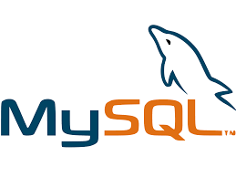
4-Three examples of popular RDBMS
4-a-MySQL : Introduction and functionalities
MySQL is the most popular open source SQL database. It is typically used for web application development, and often accessed using PHP.
The main advantages of MySQL are that it is easy to use, inexpensive, reliable (has been around since 1995), and has a large community of developers who can help answer questions.
Some of the disadvantages are that it has been known to suffer from poor performance when scaling, open source development has lagged since Oracle has taken control of MySQL, and it does not include some advanced features that developers may be used to.

Slide 8
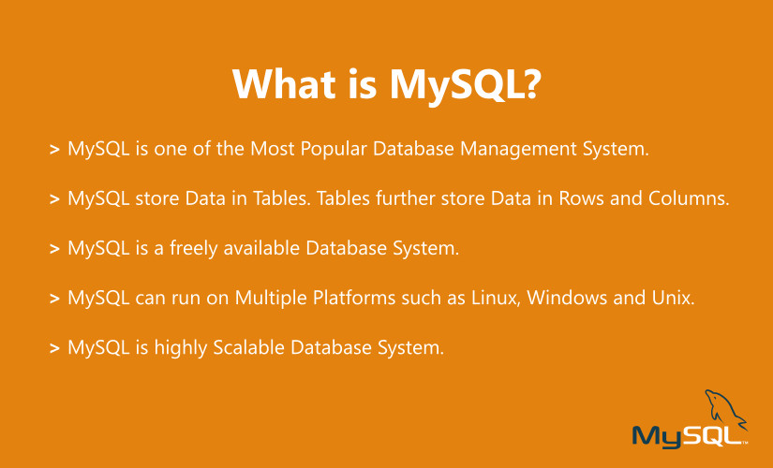
Functionalities :
Ease of Management – It is pretty easy to download and use the software.
High performance – It provides you fast loading utilities with different memory cache.
Scalable – With MySQL, you can scale anytime you like. It is really easy to create data warehouses including an enormous amount of data.
Compatibility – MySQL is compatible with all modern platforms like Windows, Linux, Unix.
Performance – MySQL gives you high-performance results without losing essential functionality.
Complete Data Security – Only the authorized users can access the database. Complete security for the data.
Low Cost – It is free to use.
Memory Efficiency – MySQL has low memory leakage.

Slide 9

Drawbacks of MYSQL
*MySQL version less than 5.0 doesn't support ROLE, COMMIT, and stored procedure.
*MySQL does not support a very large database size as efficiently.
*MySQL doesn't handle transactions very efficiently, and it is prone to data corruption.
*MySQL is accused that it doesn't have a good developing and debugging tool compared to paid databases.
*MySQL doesn't support SQL check constraints.

Slide 10

4-b-PostgreSQL :Introduction and functionalities
POSTGRESQL is an advanced, enterprise class open source relational database that supports both SQL (relational) and JSON (non-relational) querying. It is a highly stable database management system, backed by more than 20 years of community development which has contributed to its high levels of resilience, integrity, and correctness. PostgreSQL is used as the primary data store or data warehouse for many web, mobile, geospatial, and analytics applications. The latest major version is PostgreSQL 12.

Slide 11
Functionalities of PostgreSQL
-Free to download,Compatible on several operation systems,Compatible with various programming languages,.
-Compatible with Data Integrity: Primary Keys,UNIQUE, NOT NULL, Foreign Keys, Explicit Locks, Advisory Locks, Exclusion Constraints
-Support multiple features of SQL: PostgreSQL supports various features of SQL which include the followings:
-MVCC (Multi-Version Concurrency Control).
-It supports multiple Indexing such as Multicolumn, Partial, B-tree, and expressions.
SQL sub-selects.
Complex SQL queries.
Streaming Replication
It supports transactions, Nested Transactions through Save points.
Just-in-time compilation of expressions
Table partitioning
-Compatible with multiple data types
-Highly extensible: PostgreSQL is highly extensible in several phases which are as following:
-Secure: It is safe because it follows several security aspects,
-Application Program Interface (GSSAPI), SCRAM-SHA-256, Security Support Provider Interface (SSPI), Certificate, and so on.
-PostgreSQL supports Column and row-level security.
-Highly Reliable: It is highly reliable and also provide disaster recovery such as:
-It supports different types of Replication like Synchronous, Asynchronous, and Logical.

Slide 12
Drawbacks of PostgreSQL
-PostgreSQL does not support the various open-source applications as compared to MySQL.
-In this, creating replication is a bit complex.
-It is not maintained by one company.
-PostgreSQL speed performance is not as good as compare to further tools.
-It is a bit slow as compared to MySQL.
-Sometimes, the installation process is not easy for the learners

Slide 13
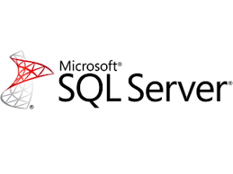
4-c-SQL SERVER:Introduction and functionalities
SQL SERVER is a relational database management system (RDBMS) developed by Microsoft. It is primarily designed and developed to compete with MySQL and Oracle database.
SQL Server supports ANSI SQL, which is the standard SQL (Structured Query Language) language. However, SQL Server comes with its own implementation of the SQL language, T-SQL

Slide 14
Drawbacks of SQL Server
Better security
With Always Encrypted, Row-Level Security, and Dynamic data masking.
Higher availability
Including AlwaysOn Availability Groups, Cloud Witness, Storage Spaces Direct, Workgroup clusters.
Improved database engine
TempDB enhancements, Query Store, Stretch Database.
More analytics
Tabular enhancements, R integration)
Various improvements to reporting
Search, custom branding, optimization for modern browsers, mobile, etc

Slide 15
5-Difference between three above
MySQL is the most popular amongst the relational databases and is a widely used one too. Offers a fully-managed database service for Google Cloud platform and is a scalable database with high availability and security at no extra cost. PostgreSQL is a fully managed and scalable relational database with high availability and security built in at no additional charge. It is a fully managed database service for the Google Cloud Platform. Is better in query optimization and query execution as compared to MySQL. PostgresQL has a storage engine which is suitable for INSERT and complex search applications such as data mining. Microsoft SQL Server developed by Microsoft has multiple editions with different feature sets and user profiles. It has some fantastic features like SQL server on Linux, resumable online index build, machine learning services, query processing improvements, and much more.

